Slide 1
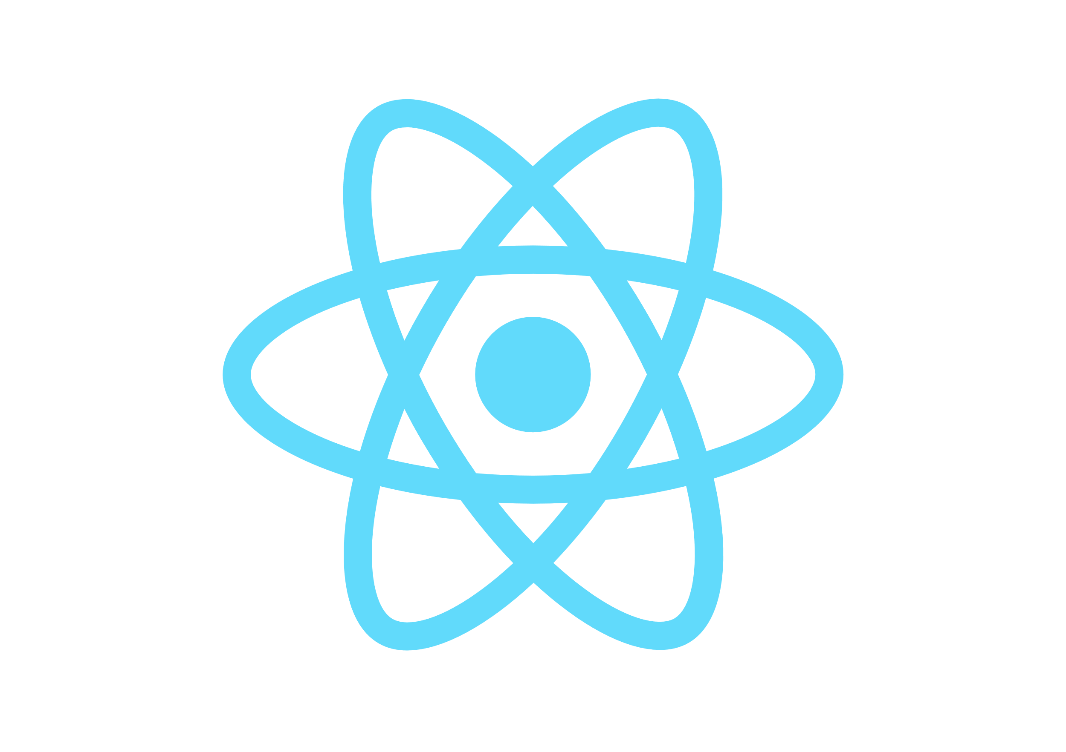
INTRO TO REACT
By Jai Joshi

Slide 2
What is React.js?
An open-source JavaScript library for building user interfaces.
Developed and maintained by Facebook.
Used to build single page applications.
Allows us to create reusable UI components.

Slide 3
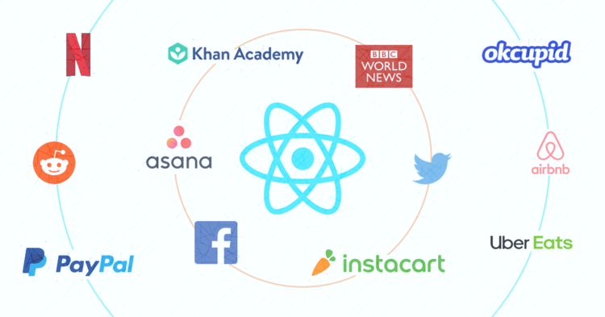
Who uses React?

Slide 4
Why should you use React.js?
Declarative code
Component-Based
React is fast!
PS. also the React dev tools are awesome.

Slide 5
Note:
React is nothing but the view, the V part of the MVC (Model View Controller)
Only a library for building UI, not a frontend framework.

Slide 6
Some fundamentals

Slide 7
Components
Building blocks of react.
Component is like a collection of HTML, CSS and JavaScript.
Written using either JavaScript or JSX

Slide 8
JSX
React uses XML-like syntax for generating component's HTML
Example:
return (
<div>
Welcome {user.name}!<br /><br />
<input type="button" onClick={handleLogout} value="Logout" />
</div>
);

Slide 9
Virtual DOM
Virtual representation of a UI is kept in memory, like a lightweight copy.
Manipulating the virtual DOM is much faster than real DOM, because nothing gets drawn onscreen.

Slide 10
Thank You

